Slide 1
Neural Networks
Why so powerful?

Slide 2
Agenda
BMI
Example
Neural Network Anatomy
Input layer
Hidden layer
Output layer
Return to BMI

Slide 3
What is Body Mass Index (BMI)?
Literally:
What is it a proxy for?
From the high-level perspective of modeling / machine learning?
What is it called when you combine two variables in a novel way?

Slide 4
Question/Challenge
Can a Neural Network calculate BMI?
[switch to code]

Slide 5
Question/Challenge
Can a Neural Network calculate BMI?
YES!
I would argue this is a big deal. Before I get to that, let’s talk about what’s happening happens in a neural network.

Slide 6
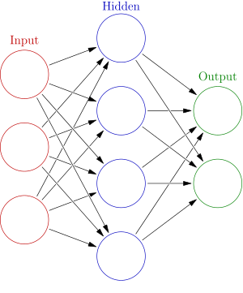
Anatomy of a fully connected neural network
It is composed of
An input layer,
A number of hidden layers, and
An output layer
The lines between represent activations—number values in the Real Numbers (-∞,∞)
A N-layer neural network has N-1 hidden layers.
The image to the left is a 2-layer NN.
The “1st layer” is the first non-input layer.

Slide 7
Input Layer Anatomy
The input layer is analogous to the input dataset. That is, there will be as many nodes as there are variables for a given observation. This example has three input variables (intercept not pictured) .
The values of X (often indexed as the zero-th activation) are passed to the first hidden layer.

Slide 8
Hidden Layer Anatomy—there can be several
The number of nodes in a hidden layer(s) is a hyperparameter, i.e. arbitrarily chosen to maximize performance.
Within each node within a hidden layer two things occur (in order):
Linear regression using the input activation
Output from that regression passes through an activation function.
The output (the new activation) from this is then passed as the next layer’s input activation.
Each node has different parameters, but uses the same input activations within a given layer.

Slide 9
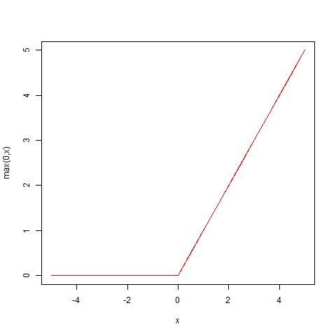
Hidden Layer Anatomy, continued
The most common activation function is the rectified linear unit (RELU):
RELU(x) =
Max(0,x)

Slide 10
Anatomy of a fully connected neural network
The number of nodes in the output layer is determined by the number of outputs. This one has two.
The output activations are manipulated into predictions, and are compared to the actual output, i.e. Y’s

Slide 11
Why on earth would we ever use neural networks?
Why, again, is it a big deal that neural networks can calculate BMI?
Who here is familiar with the concept of Peer Review?
You need only search PubMed to see that BMI has been through that wringer. There are still people arguing over the validity of BMI.

Slide 12
Why are we talking about Peer Review?
Well, for those of you familiar, peer review can be a tedious, time-consuming endeavor.
Consider a slightly different example.
[switch to code]

Slide 13
Why are we talking about Peer Review?
Our previous neural network had an input layer of 6, and two sequential hidden layers of size 16. This was sufficient to predict BMI.
Suppose instead, we added on another hidden layer, and tried to predict the likelihood of a patient developing type 2 diabetes—we know our NN is capable of simulating BMI by that point.
This is why Neural Nets are a big deal.

Slide 14
Why on earth would we ever use neural networks?
Why is being able to recreate BMI a big deal?
It means that Neural Networks are capable of creating complex transformations of raw variables that are useful for predicting outcomes.
It skips the peer review process entirely!

Slide 15
Questions
Are the final parameter values or transformations interpretable?
Almost uniformly no
Do neural networks provide measures of uncertainty (p-values, confidence intervals, standard errors, etc.)?
No
Can we perform inference using the parameter estimates in the final neural network?
Nope
Are Neural Networks highly predictive?
Yes

